Slide 1




Research Presentation/Final Presentation By Tremaine Walker 12/11/2024
Step-by-Step Guide on
Building A Gaming PC/Rig
Notes:
This is my Presentation on How to Build : A Gaming PC Step-by-Step I hope you enjoy!!!

Slide 2
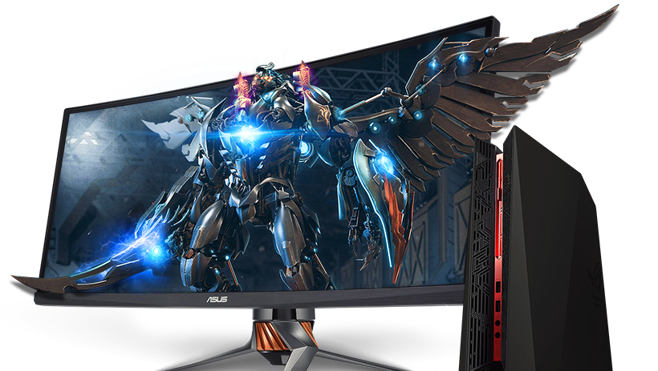
This Photo by Unknown Author is licensed under CC BY-NC
Notes:
So why build a Gaming Rig? Because it’s fun, it’s challenging, and you will always have a project to work on!
To start off whats needed for a gaming rig are : the components , salary cap, pre-plan to know what are your gaming needs and required system requirements ,the tools, and proper workplace. Let’s get started!

Slide 3

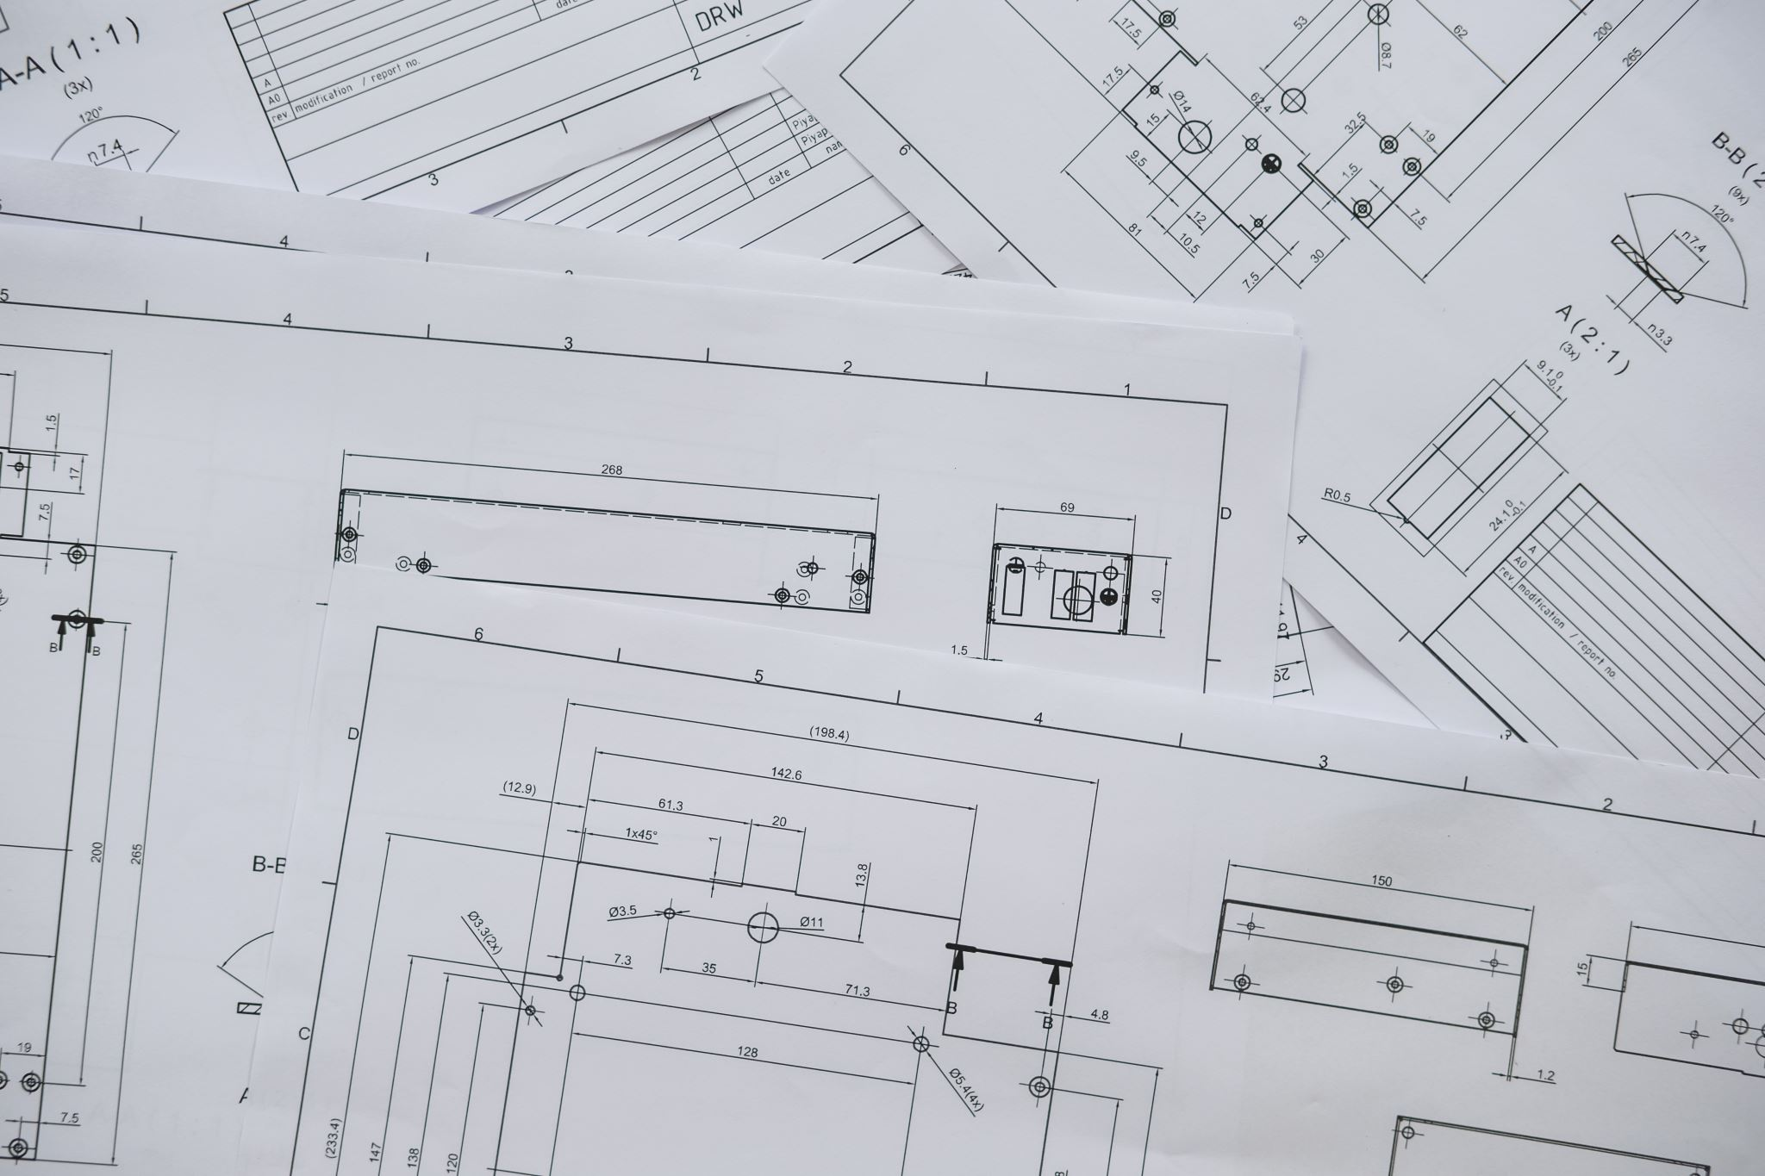
PRE-PLANNING/ Salary Cap
Notes:
When it comes to building a gaming pc you want to consider finances, if you want to buy a pre-built rig or build it yourself, what components meet your needs.
Research components you're buying and do compatibility checks, there is nothing like building a pc and finding out you got all the wrong parts , or they're not up to par for your gaming needs.
Looking for deals and discounts on sites like Newegg, and PCPartPicker is also a cheaper way to go.

Slide 4

TOOLS
Notes:
The tools you will need are simple: Flat head , regular sized and small sized screwdriver, pliers, thermal paste, cable ties, and sometimes anti-static wrist strap.

Slide 5
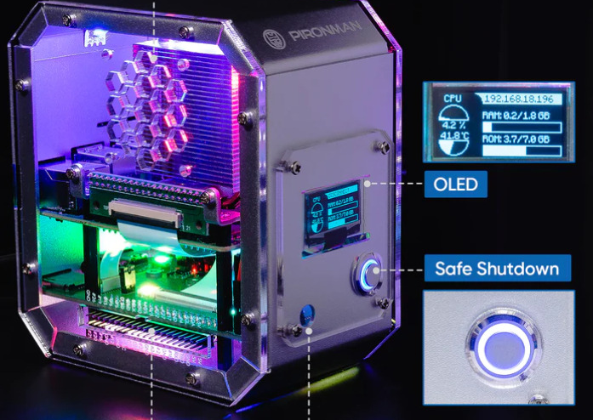
PC CASE
This Photo by Unknown Author is licensed under CC BY-SA
Notes:
The case you buy sets the tone for your whole PC build. Every PC case lists the motherboard formats it supports. The three main layouts are ATX (a full-size, mainstream motherboard), MicroATX (a smaller variant with fewer expansion slots and other surface-area-related features), and Mini-ITX (even smaller, usually offering just a single slot for a video card). Make sure you take into account your placement for your PC case whether you want to place in on the ground, on top or under a desk or wherever.

Slide 6
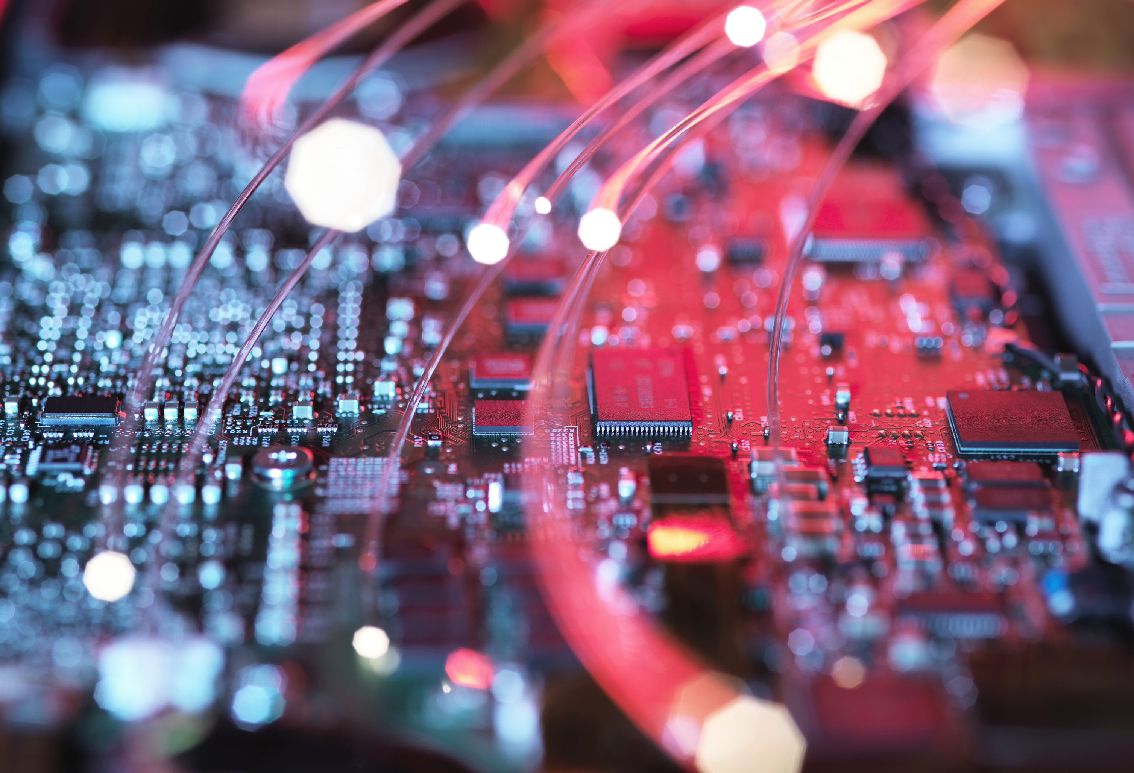
Motherboard
Notes:
PC builders will argue that the motherboard should be the first thing you select in a PC build, and they are correct , the Motherboard is the backbone of your PC build.
(1) You need a motherboard that works with the CPU you choose; (2) the board should be the right size and shape ("form factor") for your case; and (3) it should have the external ports and internal expansion slots you need for what you plan to install.

Slide 7
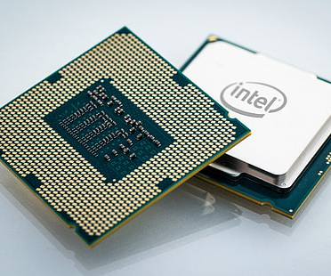
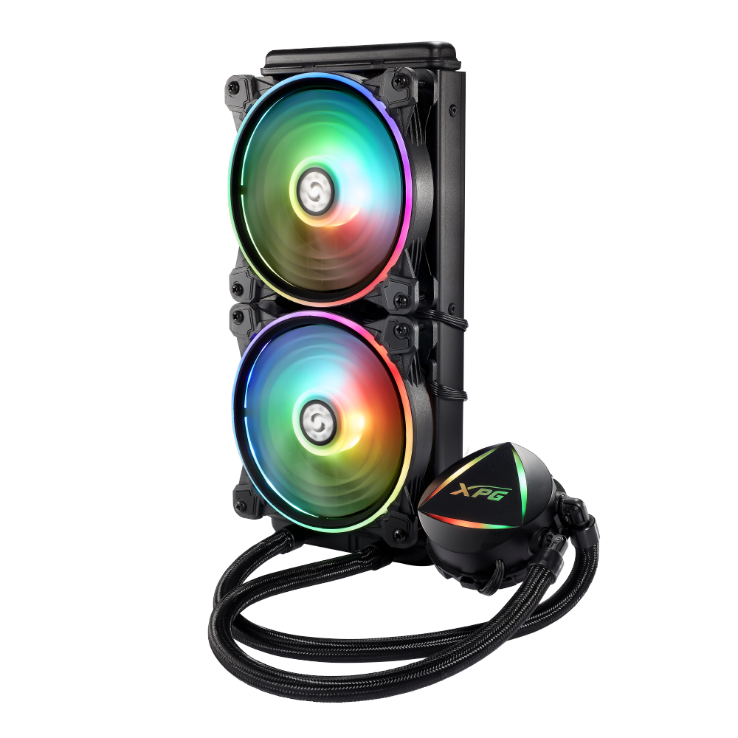
CPU/ CPU Cooler
This Photo by Unknown Author is licensed under CC BY
Notes:
You choose a CPU in concert with your motherboard; one must support the other. If you're going for high-end gaming and content creation you want a high-end CPU, the more Cores the better.
If your are going latest generation CPUs then your best bet will be a liquid cooling system , they work better ensemble with the CPU’s cooling needs than a regular heatsink.

Slide 8
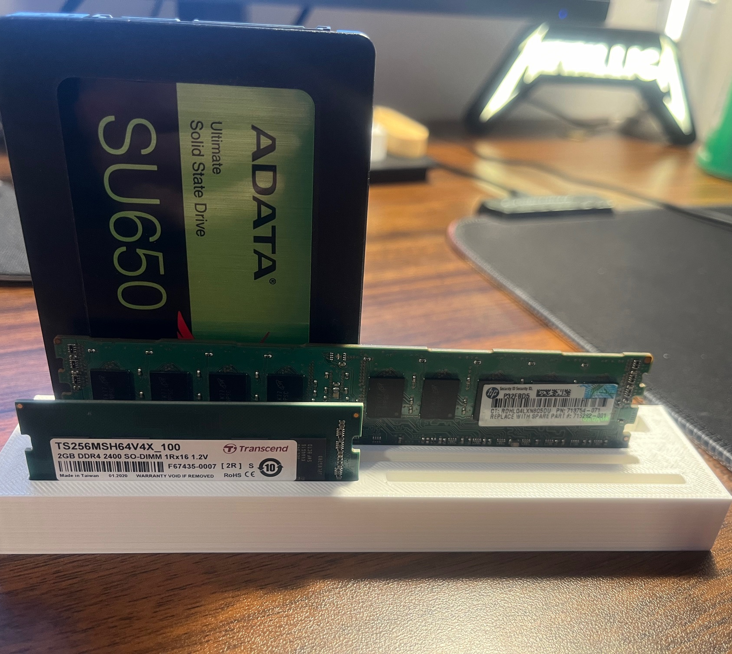

Ram (Random Access Memory)
Notes:
Your how much RAM you need and have access to, as well as how many you are able to install will depend on your Motherboard.

Slide 9
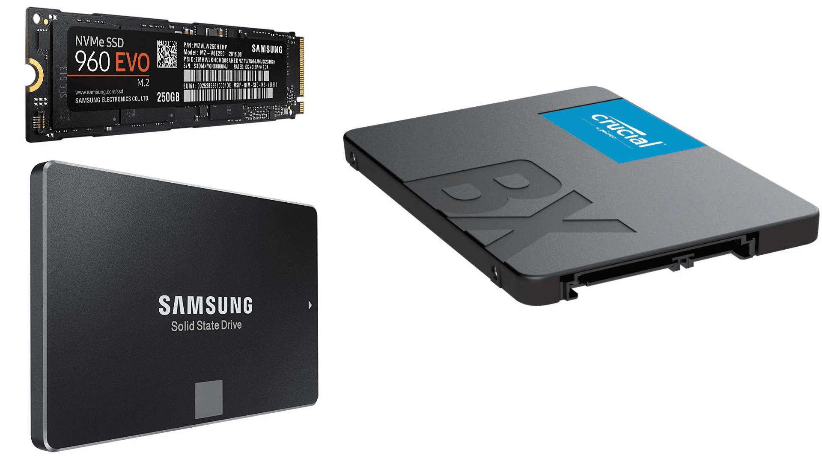
SSD (SOLID STATE DRIVE)
This Photo by Unknown Author is licensed under CC BY-NC
Notes:
The smart default pick with new motherboards is a solid-state boot drive in the M.2 format supporting PCI Express data transfers. You can choose how much storage you need but the safe bet would be 2TB to 4TB.

Slide 10
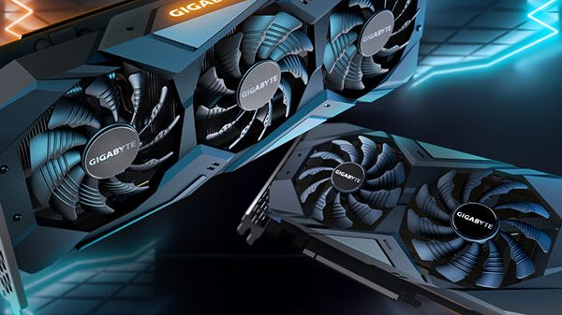
GRAPHICS CARD
This Photo by Unknown Author is licensed under CC BY
Notes:
Besides Motherboard, or CPU, the Graphics card will be your most expensive purchase but will also tie into the peak performance of your games and content. If you want 4K graphics, then need to make sure you get a 4K graphics card that works with your build.

Slide 11
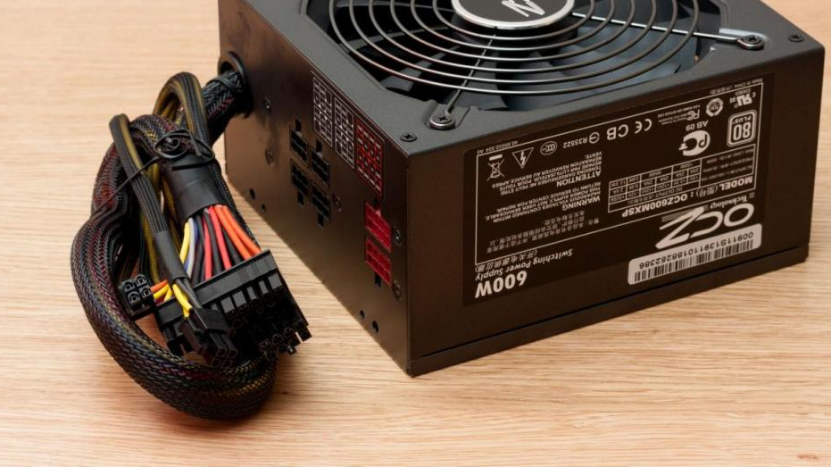
Power Supply
This Photo by Unknown Author is licensed under CC BY-SA
Notes:
What is a PC build without the proper power source to keep you gaming into the night.

Slide 12
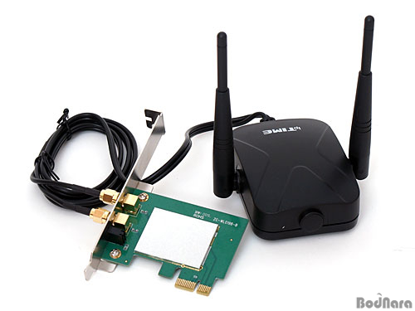
WI-FI CARD
This Photo by Unknown Author is licensed under CC BY-NC-ND
Notes:
Unless you get a wi-fi card for your build, you will just have to watch your friends' game while you sit on the sidelines.

Slide 13
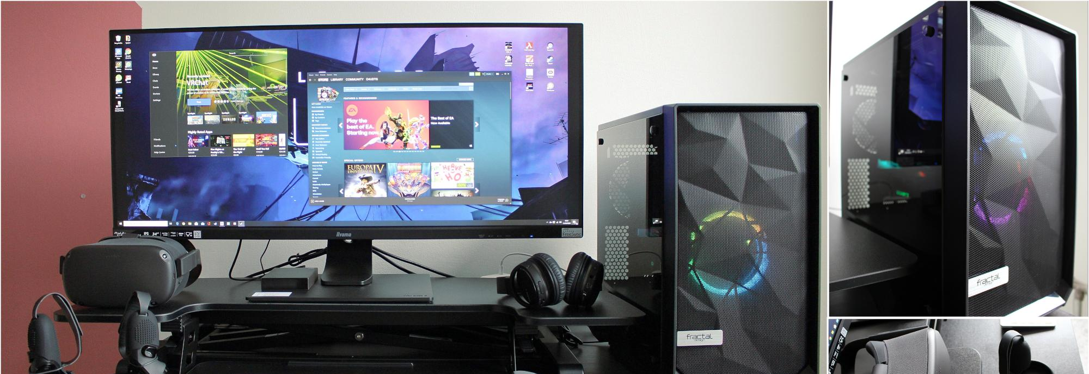
BUILDING THE RIG
This Photo by Unknown Author is licensed under CC BY
Notes:
Step 1 - Preparing the Case
Open the case
Install standoffs
Step 2 - Installing the Motherboard
Align the motherboard with standoffs
Secure the motherboard with screws
Step 3 - Installing the CPU
Open the CPU socket
Place the CPU
Secure the CPU
Step 4 - Installing the RAM
Open the RAM slots
Insert the RAM sticks
Secure the RAM
Step 5 - Installing the Storage
Mount the SSD/HDD
Connect the data and power cables
Step 6 - Installing the GPU
Insert the GPU into the PCIe slot
Secure the GPU with screws
Step 7 - Installing the Cooling System
Install the CPU cooler
Install case fans
Step 8 - Connecting the Power Supply
Mount the PSU
Connect the power cables to the motherboard, CPU, GPU, and storage
Step 8 - Cable Management
Organize and secure cables
Ensure proper airflow
Step 10 - Final Checks
Double-check all connections
Close the case
Step 11 - Installing the Operating System
Insert the OS installation media
Follow the installation prompts

Slide 14

Citations Burek, John. “How to Build a PC: The Ultimate Beginner’s Guide.” PCMAG, 26 May 2024, www.pcmag.com/how-to/how-to-build-a-pc-the-ultimate-beginners-guide.

